Slide 6
RheinCargo
Modern service provider with a long-standing tradition
RheinCargo GmbH & Co. KG was founded in 2012 as a joint venture between two companies: “Häfen und Güterverkehr Köln AG” (HGK) and “Neuss Düsseldorfer Häfen GmbH & Co. KG” (NDH).
Each company has a 50 per cent holding in RheinCargo.
Strong partner network

Slide 7
RheinCargo
Expertise & experience
Whether you need rail, waterway, port or factory transport – we have the individual solution for your transport requirements. Our expertise is based on decades of experience and extensive connections. Together with our partners, we cover the entire spectrum of the logistics industry so can offer you the best terms for your company’s success.
WELL POSITIONED

Slide 8
Performance figures
YOU CAN COUNT ON THESE
720
48
102
2.6
HECTARES
Of our own
Of our own
Billion ntkm
Port Area
Crane systems
LOCOMOTIVES
TRANSPORT capacity
1,1
18,6
MILLION TEU
Million Tonnes
Intermodal traffic
Goods Transported
18
12.9
765
34
Million Tonnes
Million Tonnes
Employees
Trainees
Port traffic
Water-side
In total

Slide 9
Your contact point
The profit centre managers
Lukas Klippel
CAROLINE CALMUND
Timo Reuter
Steffen Volkmer
Profit centre manager
Profit centre manager
Profit centre manager
Profit centre manager
Ports
Regional transport
Plant transport
Long-distance transport

Slide 10
Hafen

Slide 11
Ports
Brief profile of profit centre
TEAM
Around 140 employees covering sales, operations and technology
Active at seven port locations
Six locations with our own operations (Neuss, Düsseldorf and Cologne)
INDUSTRIES/CUSTOMERS
Broad spectrum of customers and industries
STRUCTURE
Cross-location management by a small, dynamic team at the Neuss, Düsseldorf and Cologne branches
720
48
Hectares
Of our own
Port Area
CRANE SYSTEMS

Slide 12
The range
For our customers
Handling and storage services
In combined transport and in the container sector
Liquid goods, dry bulk goods
“Traditional” port handling
Organisation of transport chains
Technical services in the area of crane and handling systems
1,1
18.6
12.9
Million TEU
Million Tonnes
Million tonnes
Intermodal traffic
Port handling
waterside

Slide 13
The added value
For our customers
TODAY:
Standardisation of our service processes across location boundaries
Improving service quality and greater transparency
Customised solutions by bundling expertise tailored to customer needs
Joint management of future transformation processes
… AND IN THE FUTURE:
Securing and expanding the service portfolio at our established locations as a reliable partner for industry and trade
Development and expansion of the range of services, especially surrounding technical service

Slide 14
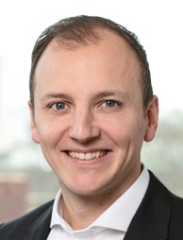
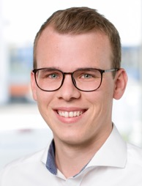
Your contact point
In the port profit centre
Lukas Klippel
MARCEL BECK
Profit centre manager
Ports
Sales Manager
Ports
+49 (0)221 390 – 2900 lukas.klippel@rheincargo.com
+49 (0)221 390 – 2905 marcel.beck@rheincargo.com

Slide 16
Regional transport
Brief profile of profit centre
TEAM
Around 260 employees covering operations
Planning and distribution
Engine driver, shunting attendant, wagon master
INDUSTRIES/CUSTOMERS
Wide range of customers and transport goods from a range of production areas
STRUCTURE
Management across locations by one team
32
500
Of our own
Of our own
Locomotives
Freight Wagons

Slide 17
The range
For our customers
Professional railway logistics in and around the ports of Cologne, Neuss and Düsseldorf
Block train transport
Wagon group and single wagon transport
Special services in the shunting area
Services customised to the needs of local industry

Slide 18
The added value
For our customers
TODAY:
Reliable performance through flexible use of resources
Expert service provision backed by many years of experience
… AND IN THE FUTURE:
Improving efficiency of service provision
Expansion of transparency and communication
Closer cooperation with the customer

Slide 19
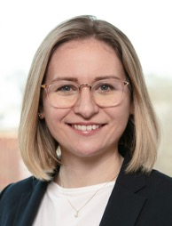
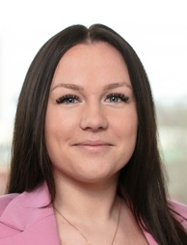
Your contact point
In the Regional transport
profit centre
CAROLINE CALMUND
JULIA SCHNECK
Niklas Diel
Profit centre manager
Regional transport
Sales
Regional transport
Sales
Regional transports
+49 (0)221 390 – 1175 caroline.calmund@rheincargo.com
+49 (0)221 390 – 1177 julia.schneck@rheincargo.com
+49 (0) 221 390 – 1179
niklas.diel@rheincargo.com

Slide 21
Plant transport
Brief profile of profit centre
TEAM
115 employees at seven locations
24/7 shift work 365 days a year if required
INDUSTRIES/CUSTOMERS
Primarily chemicals and mineral oil
STRUCTURE
A Head of Operations who manages the operational framework conditions of the locations
A Head of Sales and Controlling for the professional acquisition of new locations and the optimal management of current contracts
Two project managers for operational development for the sustainable optimization and management of personnel and operational processes at the locations

Slide 22
The range
For our customers
Customised shunting services in the siding area
Individual services within a company division, e.g. loading and monitoring activities during loading and unloading processes, monitoring of the railway infrastructure, provision of a railway operations manager (BOA)
References:
coal & coke
in Bottrop
EBL
in Bavaria
Mineral oil
in Flörsheim & Ludwigshafen
BETWEEN SHIP AND BLAST FURNACE
Maintenance of a railway siding
SHUNTING & FILLING

Slide 23
The added value
For our customers
TODAY:
Most stringent safety standards and high reliability
Shunting services in critical production processes
Close dialogue with our customers to fine-tune our service and adapt it to current circumstances
… AND IN THE FUTURE:
Expanding our shunting services in other sectors
Adapting our existing shunting services to the challenges of the future
Striving for long-term working relationships with our customers

Slide 24
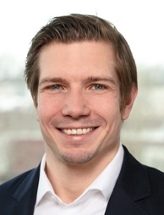
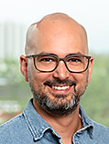
Your contact point
In the Plant transport profit centre
Timo Reuter
Thomas Nebich
Tom Karen
Profit centre manager
Plant transport
Head of Operations Plant transport
NRW
Project Manager / Project Controlling
+49 (221) 390 – 1297
timo.reuter@rheincargo.com
+49 (0) 151 23 44 55 20
thomas.nebich@rheincargo.com
+49 (0) 160 37 30 432
tom.karen@rheincargo.com

Slide 26
Long-distance transport
Brief profile of profit centre
TEAM
30 employees in planning plus three in sales
135 employees in the operations, including 108 engine drivers
INDUSTRIES/CUSTOMERS
Transport of hazardous goods (oil and chemicals)
Combined transport
Special transports
STRUCTURE
Organised into sales, planning and operation
Cross-location management from Cologne-Niehl
52
200
Locomotives
Freight Wagons
In use
In use

Slide 27
The range
For our customers
Rail transport under our own licence in Germany, Austria and the Netherlands as well as in Switzerland via our sister company RheinlandCargo Schweiz
Modern fleet, customised to our customers’ needs
Specialist in dangerous goods
Waste certificate
CO₂-neutral transport, 100% green electricity
Transport mix 2023:
82%
13%
5%
Mineral Oil
Intermodal
Extractive

Slide 28
The added value
For our customers
TODAY:
Great flexibility and short response times
High planning reliability and punctuality
All-round service provider – driven by a service philosophy that puts the customer at the centre
… AND IN THE FUTURE:
Further development of RheinCargo as a logistics service provider for all sectors
Customised services

Slide 29
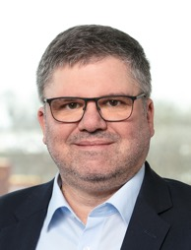
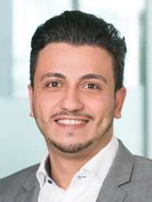
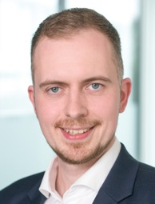
Your contact point
in the long-distance transport profit centre
Steffen Volkmer
NECATI KULA
Hendrik Otten
Profit centre manager
Long-distance transport
Sales
Long-distance transport
Sales
Long-distance transport
+49 (0)221 390 – 1780
steffen.volkmer@rheincargo.com
+49 (0)221 390 – 1178
necati.kula@rheincargo.com
+49 (0)221 390 – 1173
hendrik.otten@rheincargo.com

Slide 31
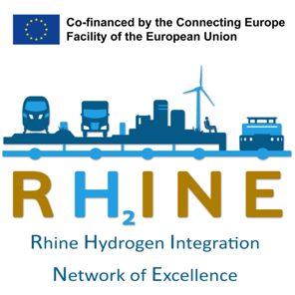
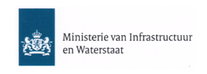
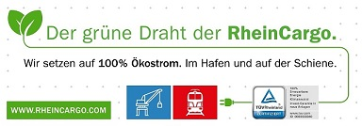
Actively protecting the environment
You can rely on this
RheinCargo reduces energy consumption and emissions by consistently combining water, rail and road transport.

